Slide 1
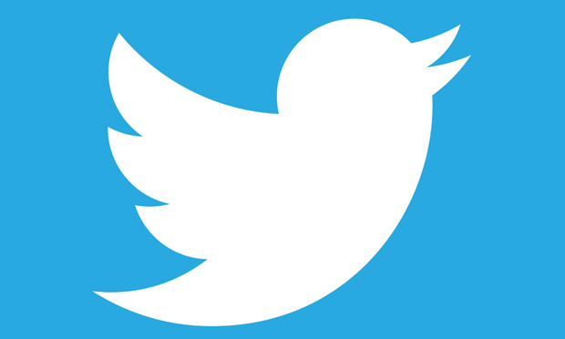


Classifying Company & Product Sentiment Based on Tweets at a Tech Conference
Mark P. & Tim M. January 2021

Slide 2
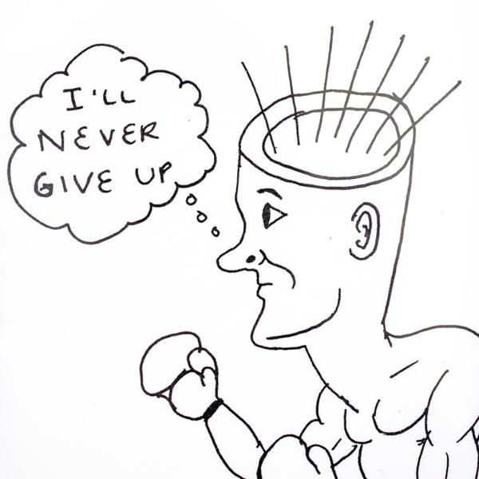
MT Head Consulting
Customer feedback insights
Product and service ideas
Product positioning
Marketing & PR planning
“Keeping an ear to the ground, and an open mind...”

Slide 3
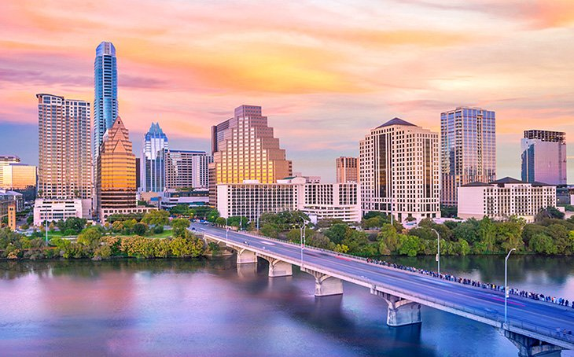

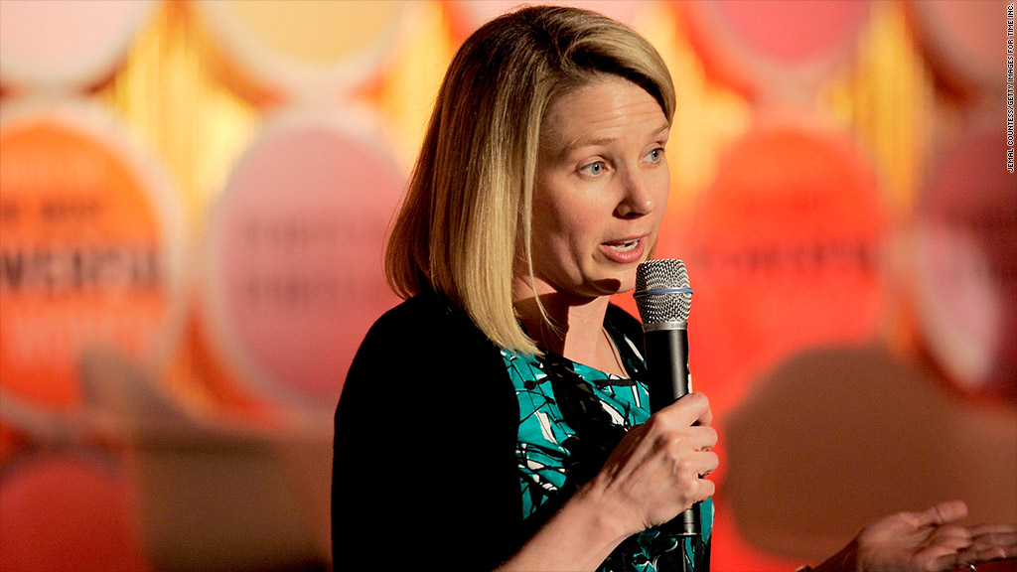
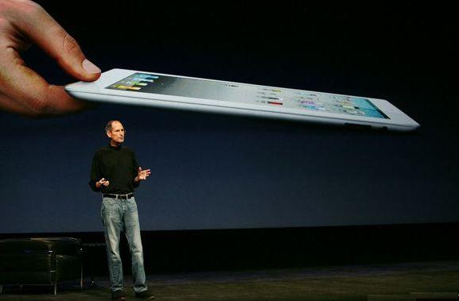
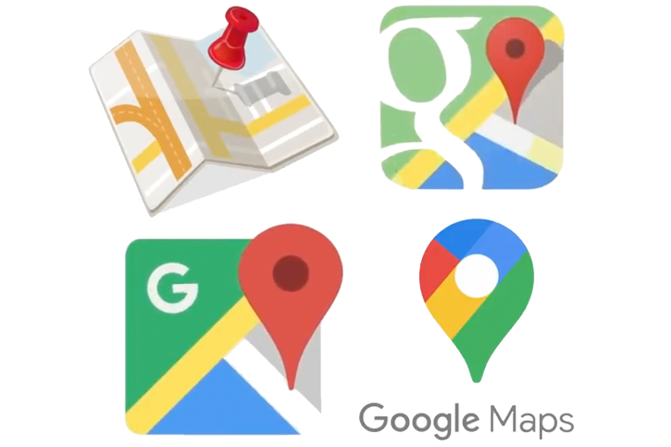
2011 Austin, TX
@ SXSW Interactive:
iPad 2 launch
Phone apps still wonky
Google Maps sends you to Death Valley
Earthquake / Tsunami in JP

Slide 4
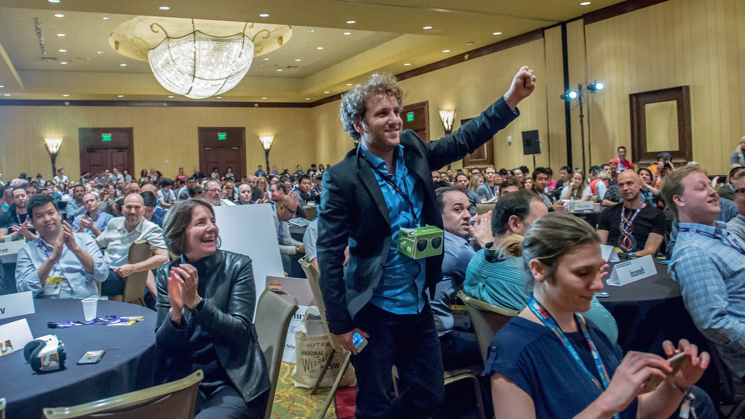
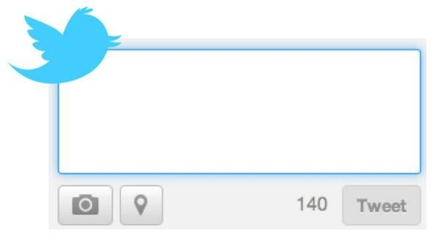
Can we glean useful insights from conference tweets?
Tweets are frequent & ubiquitous
Tech conference with focus on companies, products, services
Positive tweets: what resonates
Negative tweets: issues & complaints
Goal: Accurately classify tweets by sentiment
Just when you thought social couldn't get more overblown at #sxsw, Google may be announcing Circles today.

Slide 5
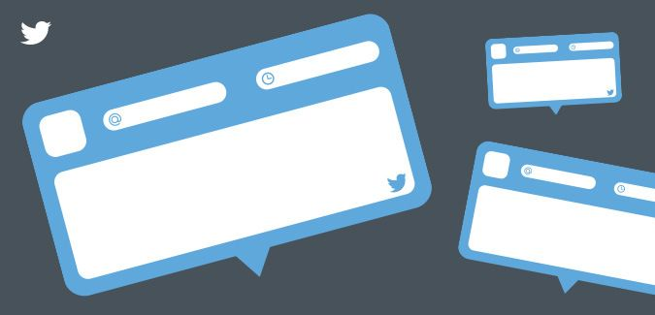
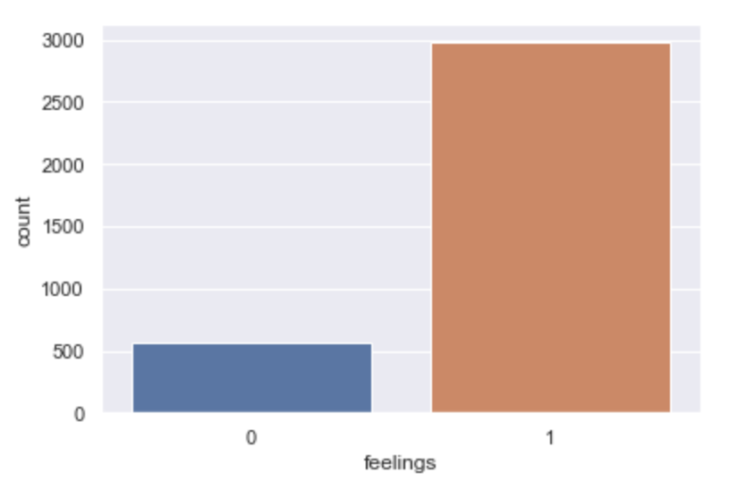
9,093 Tweets
Human classified:
Sentiment
Positive (2,978)
Negative (570)
None (5,389)
Directed at Apple or Google
Specific product / app (2,200)
Company (1,091)
16%
Data source: https://data.world/crowdflower/brands-and-product-emotion

Slide 6

Clean & Shape the Data
9,093
Address missing & duplicates
Simplification of classes
Positive or Negative
Google or Apple
NLP processing
Lowercase words
Strip out punctuation
Remove stop words (211)
~25,000 tokens
3,539
4,643 vocabulary

Slide 7
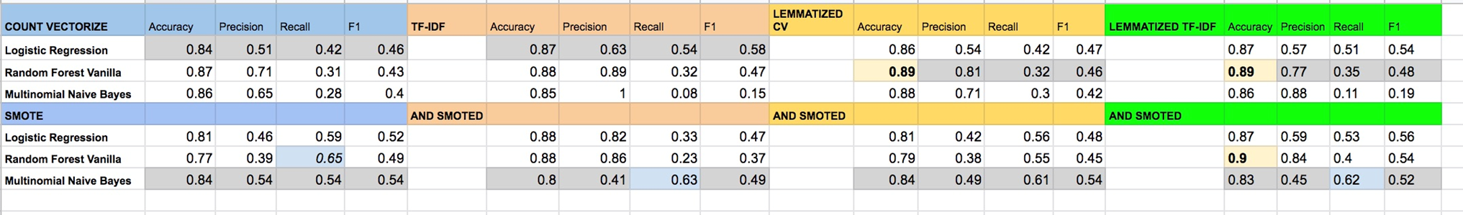
Best Model: a compromise of Accuracy & Recall
An iterative, layered approach… total of 24 models run:
Best Accuracy = 0.90
Best Recall = 0.65
86
51
101
650
Incorrectly ID as positive
Multinomial NB w/TFIDF vectorized + lemmatized + SMOTE = 0.83 accuracy
With recall of 0.62 for class 0, there is still a 38% chance of predicting positive when tweet is negative

Slide 8
Words Contributing the Most
Word | Importance
fail | 0.0179
headache | 0.0148
battery | 0.0145
long | 0.0136
need | 0.0117
think | 0.0099
design | 0.0094
suck | 0.0092
people | 0.0089
yet | 0.0085
Important to RF models:
Top words mostly negative
Long tail…many words contribute a little
Can be difficult to glean meaning w/out context

Slide 9
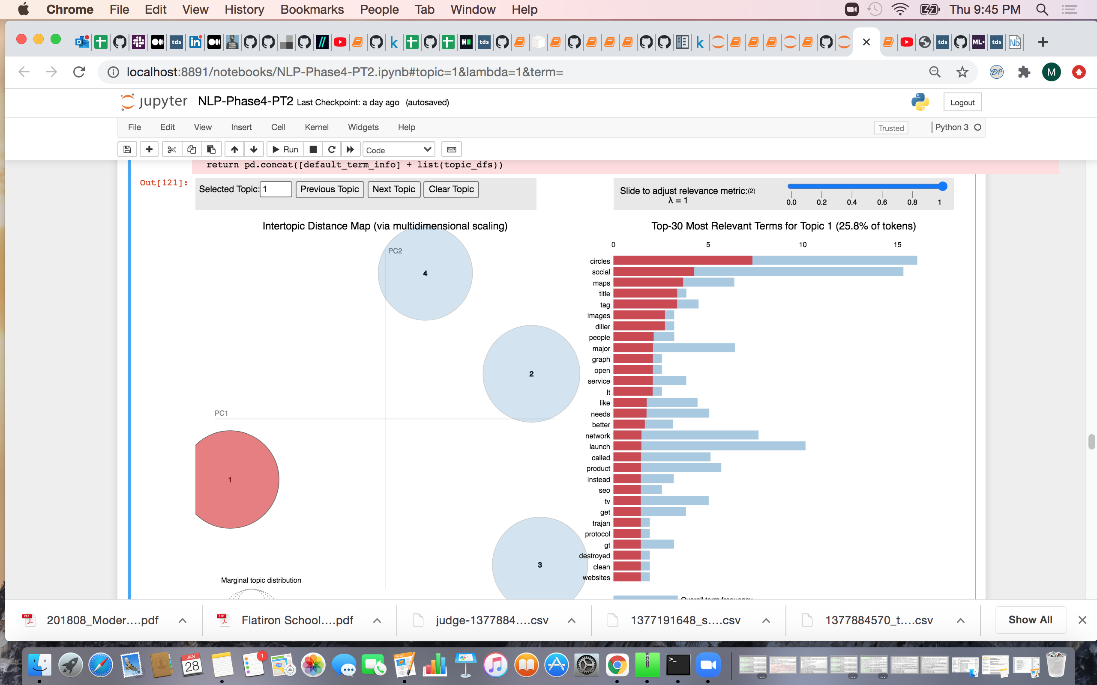
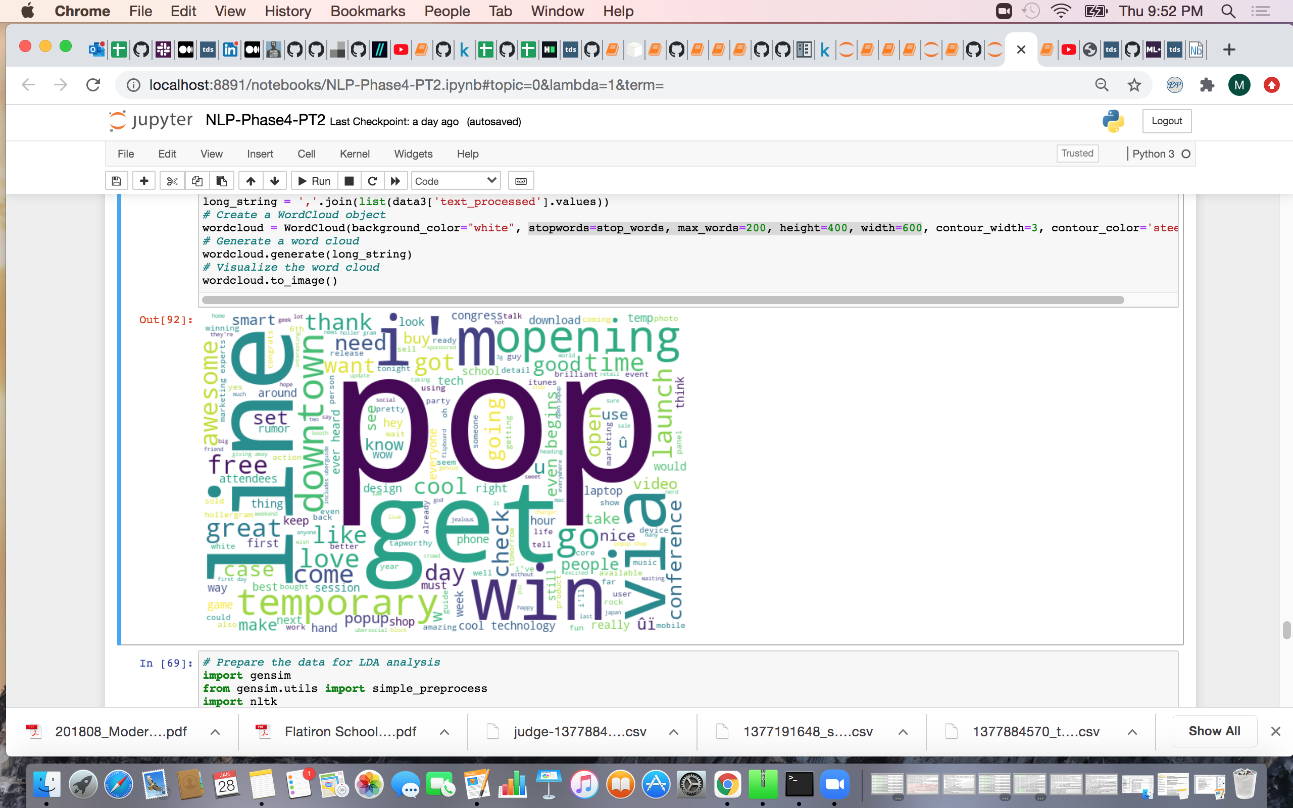
Clustering to further examine themes
Google -
Apple +
Top positive words for apple (on the left) – Word cloud based on token count Top negative themes for Google (on the right) – via LDA clustering

Slide 10
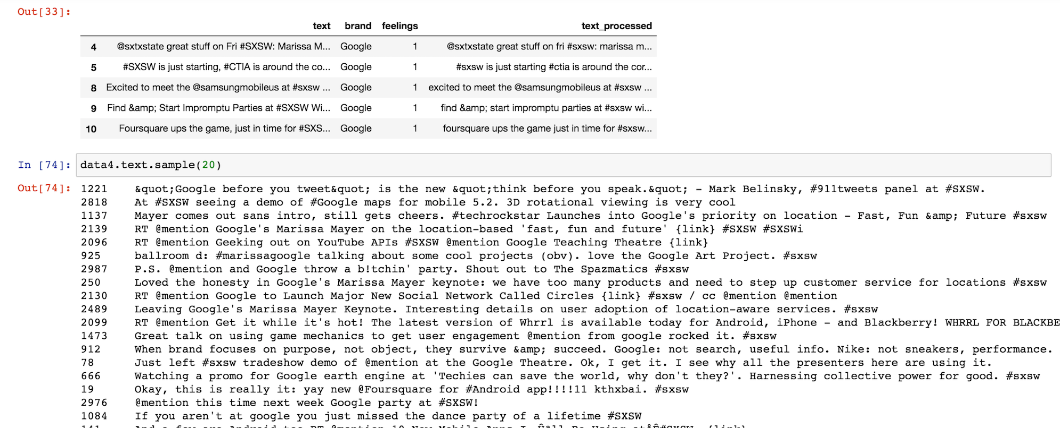
Read texts to understand context / meaning
Seeing specific words in context… the full tweet… adds meaning to themes and word lists
AKA… know thy data!

Slide 11
Sentiment may not be as polarized as assumed
TextBlob polarity scale
0
-1
+1
Negative tweets (mean = +0.02)
Positive tweets (mean = +0.21)
Used TextBlob (model) to do assess how it rates polarity of sentiment in our tweets. On a scale of -1 to +1 our negative tweets average = +0.02, and positive tweets average = +0.21

Slide 12
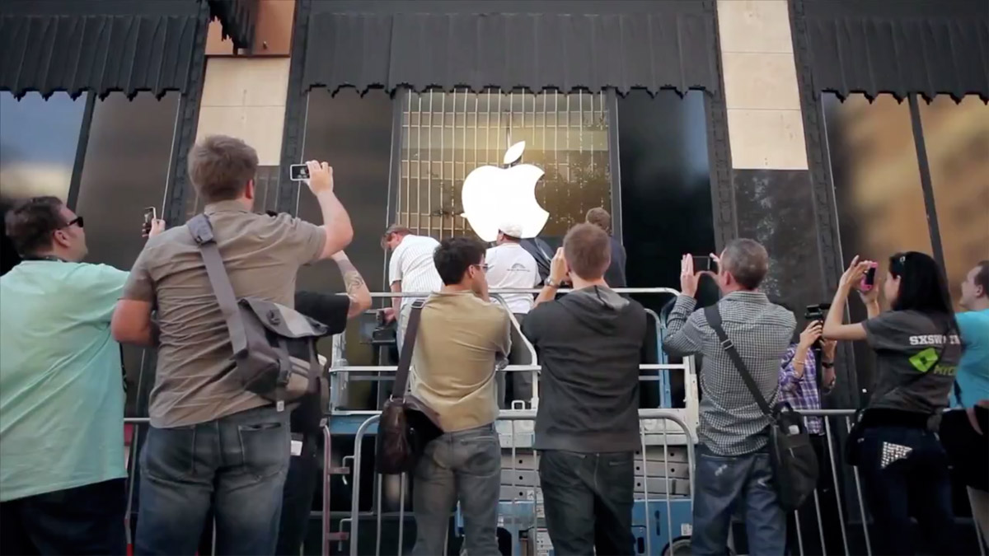
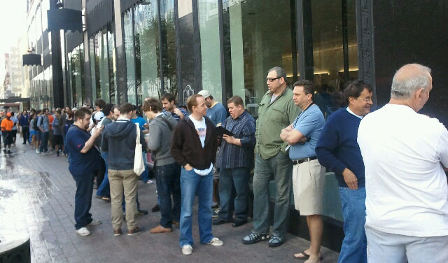
Key Findings
Accuracy good, Recall low
Class imbalance
Tweets varied; repetitive
Able to id key topics (+ / -)
Most tweets fairly neutral
Same word/topic can be both + and -
Created interactive tool for applying models to data
One of the top words = popup or pop… is it positive (can't wait to get my iPad2) or negative (long lines) ?

Slide 13
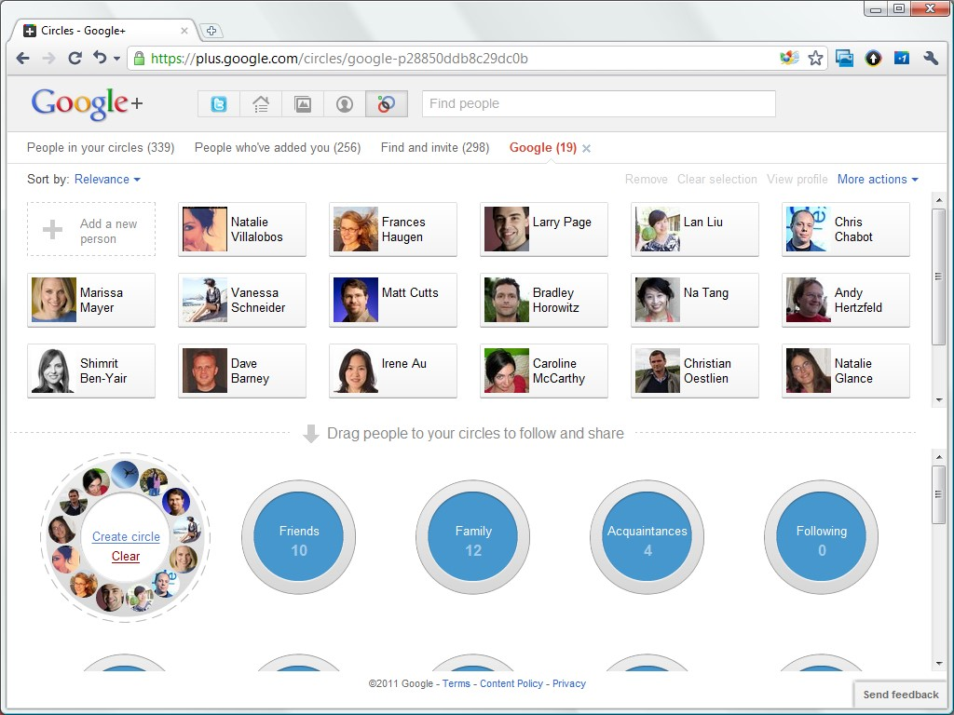
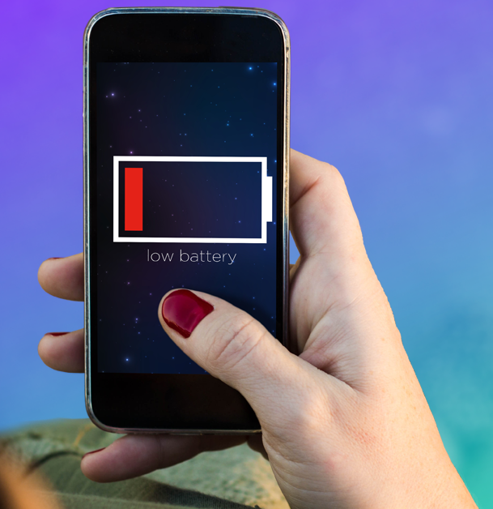
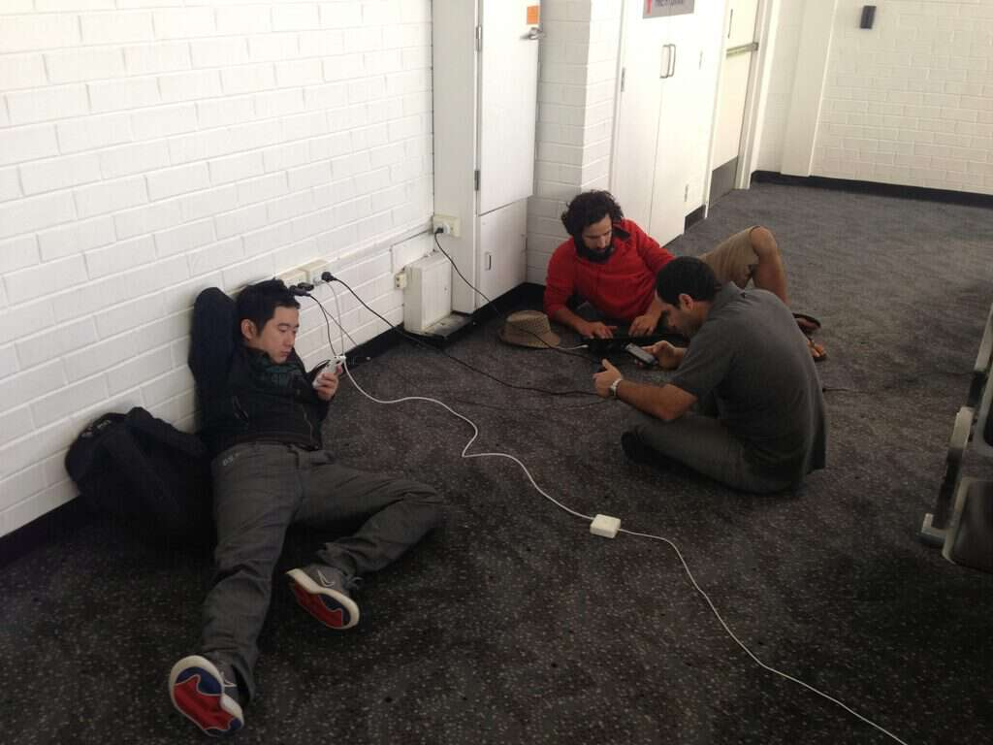
Recommendations
Google
Apple
Google Circles: too much competition
Google Maps: fix navigation errors quicker
Google Search: at risk from Microsoft Bing
Company: “focus on things that matter”
iPhone: battery lacks longevity
News: needs improvement and innovation
iPad2 Launch: long lines and poor CS
Conference: more phone charging stations
Process Improvements
Dashboard Approach: model tuned for speed and frequent reporting
Tweets: may not be the best source of actionable feedback (part of a mix)

Slide 14
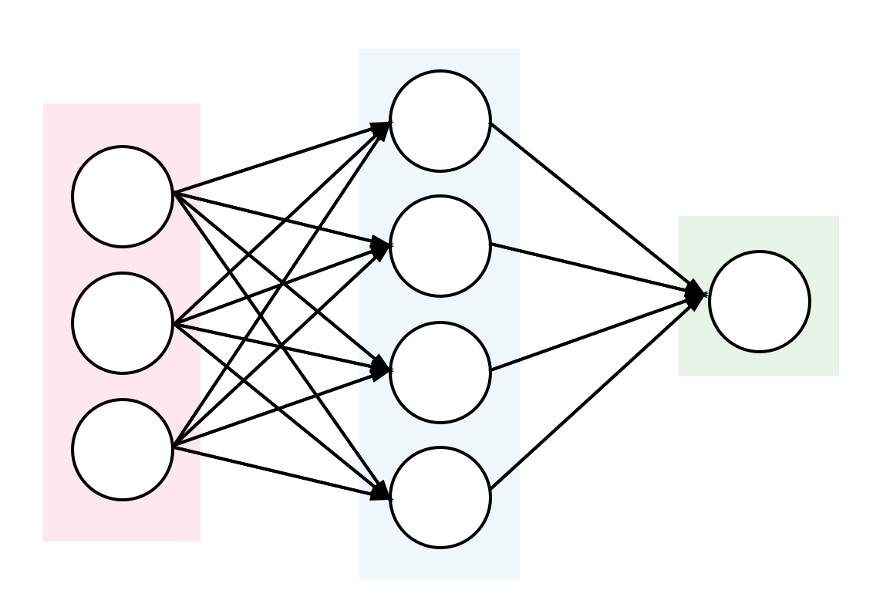
Next Steps
Improve Model Performance
Utilize bi-grams and tri-grams
Filter vocabulary by parts of speech (POS)
Explore word embedding
Try using a Neural Network
Experiment with Content
Extend data used to “neutrals”
Restrict tweets to specific roles / users
Explore different types of conferences

Slide 15
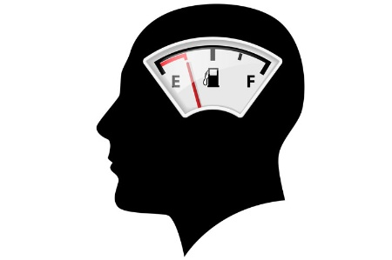
Thanks to…
Yish Lim (leader of the pack)
Stephen Enke (resident NLP expert)
Our classmates (…and happy hour companions)
and Flatiron School
For details visit: https://github.com/tcmcaleer/Google-Apple-Tweets
tcmcaleer@google.com / markpatterson8@hotmail.com

